Slide 1
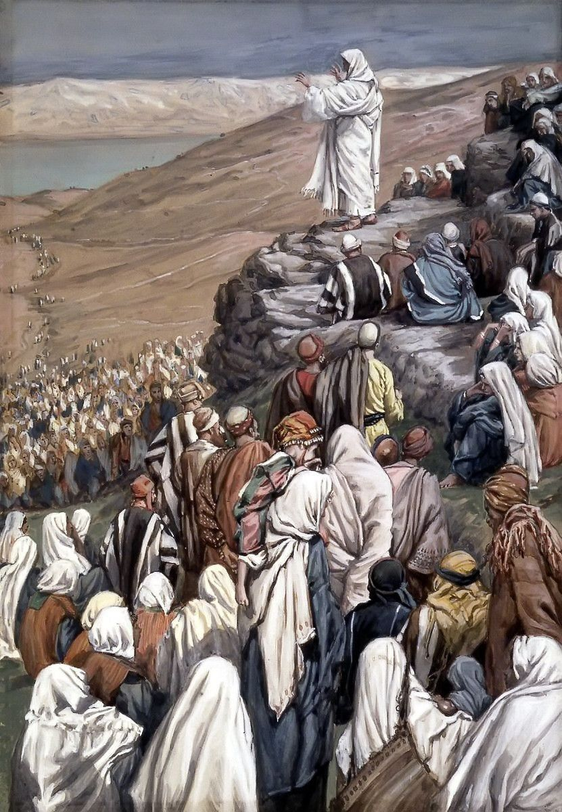
LIFE OF CHRIST
PART 22

Slide 2
Matthew 5:2 Then He opened His mouth and taught them, saying: ³ "Blessed are the poor in spirit, For theirs is the kingdom of heaven. ⁴ Blessed are those who mourn, For they shall be comforted. ⁵ Blessed are the meek, For they shall inherit the earth. ⁶ Blessed are those who hunger and thirst for righteousness, For they shall be filled. ⁷ Blessed are the merciful, For they shall obtain mercy. ⁸ Blessed are the pure in heart, For they shall see God. ⁹ Blessed are the peacemakers, For they shall be called sons of God. ¹⁰ Blessed are those who are persecuted for righteousness' sake, For theirs is the kingdom of heaven. ¹¹ "Blessed are you when they revile and persecute you, and say all kinds of evil against you falsely for My sake. ¹² "Rejoice and be exceedingly glad, for great is your reward in heaven, for so they persecuted the prophets who were before you.

Slide 3
⁹ Blessed are the peacemakers, For they shall be called sons of God.

Slide 4
The word “peacemakers” is defined this way:
Friberg: of establishing a friendly relationship between persons peace-making
Louw-Nida: a person who restores peace between people
BDAG: to endeavor to reconcile pers. who have disagreements,

Slide 5
Romans 2:5 But in accordance with your hardness and your impenitent heart you are treasuring up for yourself wrath in the day of wrath and revelation of the righteous judgment of God, ⁶ who "will render to each one according to his deeds": ⁷ eternal life to those who by patient continuance in doing good seek for glory, honor, and immortality; ⁸ but to those who are self-seeking and do not obey the truth, but obey unrighteousness -- indignation and wrath, ⁹ tribulation and anguish, on every soul of man who does evil, of the Jew first and also of the Greek; ¹⁰ but glory, honor, and peace to everyone who works what is good, to the Jew first and also to the Greek.

Slide 6
Isaiah 48:22 "There is no peace," says the LORD, "for the wicked."

Slide 7
Ephesians 2:14 For He Himself is our peace, who has made both one, and has broken down the middle wall of separation, ¹⁵ having abolished in His flesh the enmity, that is, the law of commandments contained in ordinances, so as to create in Himself one new man from the two, thus making peace, ¹⁶ and that He might reconcile them both to God in one body through the cross, thereby putting to death the enmity.

Slide 8
Colossians 1:19 For it pleased the Father that in Him all the fullness should dwell, ²⁰ and by Him to reconcile all things to Himself, by Him, whether things on earth or things in heaven, having made peace through the blood of His cross.

Slide 9
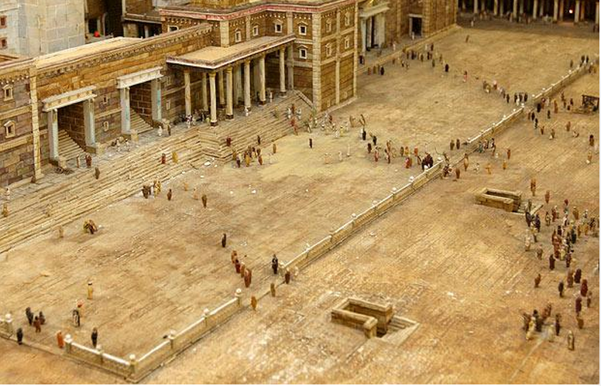

Slide 10
Romans 10:14 How then shall they call on Him in whom they have not believed? And how shall they believe in Him of whom they have not heard? And how shall they hear without a preacher? ¹⁵ And how shall they preach unless they are sent? As it is written: "How beautiful are the feet of those who preach the gospel of peace, Who bring glad tidings of good things!"

Slide 11
2 Peter 1:2 Grace and peace be multiplied to you in the knowledge of God and of Jesus our Lord,

Slide 12
1 Peter 3:10 For "He who would love life And see good days, Let him refrain his tongue from evil, And his lips from speaking deceit. ¹¹ Let him turn away from evil and do good; Let him seek peace and pursue it. ¹² For the eyes of the LORD are on the righteous, And His ears are open to their prayers; But the face of the LORD is against those who do evil."

Slide 13
Acts 21:20 "You see, brother, how many myriads of Jews there are who have believed, and they are all zealous for the law; ²¹ "but they have been informed about you that you teach all the Jews who are among the Gentiles to forsake Moses, saying that they ought not to circumcise their children nor to walk according to the customs. ²² "What then? The assembly must certainly meet, for they will hear that you have come. ²³ "Therefore do what we tell you: We have four men who have taken a vow. ²⁴ "Take them and be purified with them, and pay their expenses so that they may shave their heads, and that all may know that those things of which they were informed concerning you are nothing, but that you yourself also walk orderly and keep the law.

Slide 14
Genesis 13:8 So Abram said to Lot, "Please let there be no strife between you and me, and between my herdsmen and your herdsmen; for we are brethren. ⁹ "Is not the whole land before you? Please separate from me. If you take the left, then I will go to the right; or, if you go to the right, then I will go to the left." ¹⁰ And Lot lifted his eyes and saw all the plain of Jordan, that it was well watered everywhere (before the LORD destroyed Sodom and Gomorrah) like the garden of the LORD, like the land of Egypt as you go toward Zoar. ¹¹ Then Lot chose for himself all the plain of Jordan, and Lot journeyed east. And they separated from each other.

Slide 15
Romans 14:19 Therefore let us pursue the things which make for peace and the things by which one may edify another. ²⁰ Do not destroy the work of God for the sake of food. All things indeed are pure, but it is evil for the man who eats with offense. ²¹ It is good neither to eat meat nor drink wine nor do anything by which your brother stumbles or is offended or is made weak.

Slide 16
1 Corinthians 10:23 All things are lawful for me, but not all things are helpful; all things are lawful for me, but not all things edify.

Slide 17
Proverbs 15:17 Better is a dinner of herbs where love is, Than a fatted calf with hatred.

Slide 18
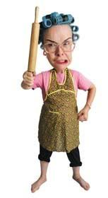
Proverbs 21:9 It is better to dwell in the corner of the housetop, Than with a contentious woman in a wide house.

Slide 19
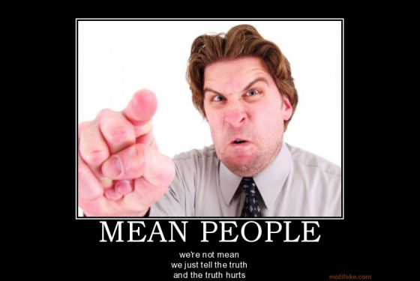
Proverbs 11:29 He who troubles his own house will inherit the wind, And the fool will be servant to the wise of heart.

Slide 20
Acts 15:37 Now Barnabas was determined to take with them John called Mark. ³⁸ But Paul insisted that they should not take with them the one who had departed from them in Pamphylia, and had not gone with them to the work. ³⁹ Then the contention became so sharp that they parted from one another. And so Barnabas took Mark and sailed to Cyprus; ⁴⁰ but Paul chose Silas and departed, being commended by the brethren to the grace of God. ⁴¹ And he went through Syria and Cilicia, strengthening the churches.

Slide 21
2 Corinthians 2:6 This punishment which was inflicted by the majority is sufficient for such a man, ⁷ so that, on the contrary, you ought rather to forgive and comfort him, lest perhaps such a one be swallowed up with too much sorrow. ⁸ Therefore I urge you to reaffirm your love to him.

Slide 22
Acts 15:28 For it seemed good to the Holy Spirit, and to us, to lay upon you no greater burden than these necessary things:

Slide 23
Romans 12:18 If it is possible, as much as depends on you, live peaceably with all men.

Slide 24
Luke 12:51 "Do you suppose that I came to give peace on earth? I tell you, not at all, but rather division. ⁵² "For from now on five in one house will be divided: three against two, and two against three. ⁵³ "Father will be divided against son and son against father, mother against daughter and daughter against mother, mother-in-law against her daughter-in-law and daughter-in-law against her mother-in-law."

Slide 25
¹⁰ Blessed are those who are persecuted for righteousness' sake, For theirs is the kingdom of heaven. ¹¹ "Blessed are you when they revile and persecute you, and say all kinds of evil against you falsely for My sake. ¹² "Rejoice and be exceedingly glad, for great is your reward in heaven, for so they persecuted the prophets who were before you.

Slide 26
The word persecute means:
Thayer: to make to run or flee, put to flight, drive away…to be mistreated, suffer persecution on account of something.

Slide 27
The word revile means:
BDAG: . to find fault in a way that demeans the other, reproach, revile, mock, heap insults upon as a way of shaming;

Slide 28
2 Timothy 3:12 Yes, and all who desire to live godly in Christ Jesus will suffer persecution.

Slide 29
Matthew 10:22 "And you will be hated by all for My name's sake. But he who endures to the end will be saved. ²³ "When they persecute you in this city, flee to another. For assuredly, I say to you, you will not have gone through the cities of Israel before the Son of Man comes. ²⁴ "A disciple is not above his teacher, nor a servant above his master. ²⁵ "It is enough for a disciple that he be like his teacher, and a servant like his master. If they have called the master of the house Beelzebub, how much more will they call those of his household!

Slide 30
Acts 5:27 And when they had brought them, they set them before the council. And the high priest asked them, ²⁸ saying, "Did we not strictly command you not to teach in this name? And look, you have filled Jerusalem with your doctrine, and intend to bring this Man's blood on us!" ²⁹ But Peter and the other apostles answered and said: "We ought to obey God rather than men. ³⁰ "The God of our fathers raised up Jesus whom you murdered by hanging on a tree. ³¹ "Him God has exalted to His right hand to be Prince and Savior, to give repentance to Israel and forgiveness of sins.

Slide 31
³² "And we are His witnesses to these things, and so also is the Holy Spirit whom God has given to those who obey Him." ³³ When they heard this, they were furious and plotted to kill them. ³⁴ Then one in the council stood up, a Pharisee named Gamaliel, a teacher of the law held in respect by all the people, and commanded them to put the apostles outside for a little while. ³⁵ And he said to them: "Men of Israel, take heed to yourselves what you intend to do regarding these men. ³⁶ "For some time ago Theudas rose up, claiming to be somebody. A number of men, about four hundred, joined him. He was slain, and all who obeyed him were scattered and came to nothing.

Slide 32
³⁷ "After this man, Judas of Galilee rose up in the days of the census, and drew away many people after him. He also perished, and all who obeyed him were dispersed. ³⁸ "And now I say to you, keep away from these men and let them alone; for if this plan or this work is of men, it will come to nothing; ³⁹ "but if it is of God, you cannot overthrow it -- lest you even be found to fight against God." ⁴⁰ And they agreed with him, and when they had called for the apostles and beaten them, they commanded that they should not speak in the name of Jesus, and let them go. ⁴¹ So they departed from the presence of the council, rejoicing that they were counted worthy to suffer shame for His name. ⁴² And daily in the temple, and in every house, they did not cease teaching and preaching Jesus as the Christ.

Slide 33
2 Corinthians 4:17 For our light affliction, which is but for a moment, is working for us a far more exceeding and eternal weight of glory, ¹⁸ while we do not look at the things which are seen, but at the things which are not seen. For the things which are seen are temporary, but the things which are not seen are eternal.

Slide 34
Revelation 2:10 "Do not fear any of those things which you are about to suffer. Indeed, the devil is about to throw some of you into prison, that you may be tested, and you will have tribulation ten days. Be faithful until death, and I will give you the crown of life.

Slide 35
James 1:12 Blessed is the man who endures temptation; for when he has been approved, he will receive the crown of life which the Lord has promised to those who love Him.

